Slide 1
Tips for a Successful Hill Visit
Sean Glennon
Community Development Director
Quincy, MA

Slide 2
Why Connect?
Members of Congress WANT to hear how federal programs are operating – especially when there is good news and success stories to share
It is important to seek their support
They (and staff) need to be educated
Building relationships is key

Slide 3
How to Connect
Establish a relationship with the person in your Congressional member’s office who handles housing policy (or Legislative Dir.)
Keep them informed of news/events throughout the year, not just during CD Week
Ways to connect include phone calls, e-mail, social media, photo-ops, & meetings
Notes:
Don’t presume Congressmen/staff are at familiar with the programs you’re talking about. There is staff turnover on a regular basis.

Slide 4
How to Connect
Capitol Hill Switchboard: (202) 224-3121
Senators: https://www.senate.gov/senators/
House: https://www.house.gov/representatives/find-your-representative

Slide 5
When to Connect
Connect during the NCDA Winter Meeting. Blocks of time are carved out of the agenda for this purpose. Or skip a session if you must.
Connect with your Congressional Members during recess periods
They will be in their home districts
They will have more time to meet with you
They will be able to tour local projects
National Community Development Week is always held during a recess period (generally the week after Easter)

Slide 6
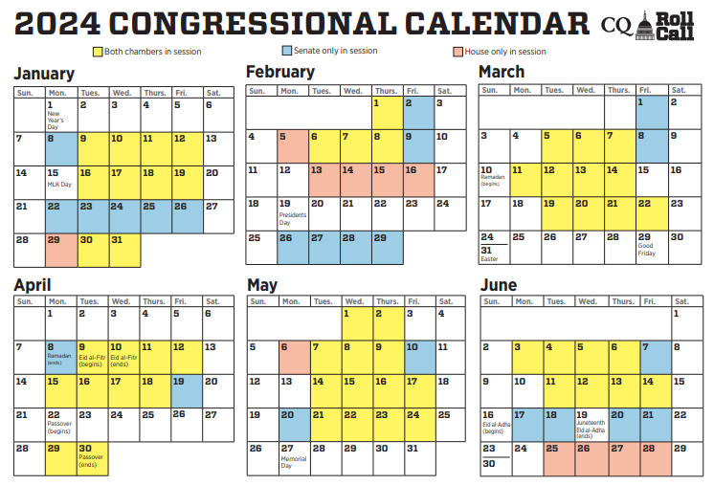
2022 Congressional Calendar (Rollcall.com)
https://rollcall.com/app/uploads/2023/11/2024CQRCCongressionalCalendar.pdf

Slide 7
Meetings
At first meeting (or for new staff) give a summary of how CPD block grant programs operate in your community/district/state
Don’t assume they know CDBG as well as you do – there are lot of federal programs they vote for and hear about
Come prepared with facts, figures, grant amounts, grant reductions, leveraged amounts, accomplishments, etc.
Notes:
Relevant committees: House or Senate Subcommitee on Transportation-Housing and Urban Development Appropriations (T-HUD); House Committee on Financial Services; House Subcmte on Housing and Community Opportunity; Senate Banking Cmte

Slide 8
Meetings
Illustrate differences between programs
Explain why the programs are essential; “entitlement” has a negative connotation
Put a face to the programs; bring a beneficiary; pictures of activities in action; testimonials; etc.
Be brief; speak in “plain English”; leave copies of comprehensive, simple backup.

Slide 9
Meetings
Be flexible, plan on getting only 15 minutes
Try to find a partner to bring with you
MA model: Meet as a state/caucus
Do research on your member, find out if they serve on a relevant committee (T-HUD; Appropriations):
https://senate.gov/committees/index.htm
https://www.house.gov/committees/

Slide 10
Meetings
Make a request. Ask them to:
attend a CD Week event
attend projects tour during a recess period
read a “floor piece”
Let them know which projects were/are funded by CDBG/HOME
Come across as a partner/resource
Notes:
All HUD funding in Hurricane Sandy bill was CDBG-funded.

Slide 11
Follow Up
Follow up is very important; the face to face is not enough
Send a thank you e-mail or letter to those present; summarize the points you made; avoid long-winded communications; don’t send large attachments (1 page is good)
Repeat the request from the meeting
Talk about impact of decreased funding

Slide 12
Annual Checklist
Communicate with your Congressional Members throughout the year
Meet with Congressional Members (or their staff) in person or virtually during a recess period, preferably during CD Week or NCDA Winter mtg.
Share highlights of CAPER; PR51 or develop one-pager (# of people served, by income; brief description of projects funded; needs met with the program funding; unmet program needs)
Invite them to CD Week events; ground-breakings; ribbon-cuttings
Send them copies of press releases; ask them to offer a quote
Remember, they want to (and need to) hear from you
Notes:
*Subgrantees – Chamber of Commerce; Elder Services; Veterans Services

Slide 13
Other Tips
If Congressional Member doesn’t come to your events, give them an award. They will likely show up for that.
Best time to schedule an in-person meeting is during recess/district periods; though virtual meetings have become a good way to “stretch” the calendar
10-minute photo ops are a great option
Follow your members of Congress on Facebook, Twitter and Instagram

